Slide 1
Database Management Systems
Project Report
GROUP 8

Slide 2
Group Members :
Charan Reddy 14CS10037
Madhu Kumar 14CS10012
Sai Bharath 14CS10020
Muni Lohith 14CS10026
Anirudh Gopu 14CS10015

Slide 3
Large Scale Graph Processing
on Hadoop
Objective : The objective of the project is to process large graphs in a Apache Spark framework and compute its profile performance.
Additional Implementation : PageRank and Shortest Path Query
Platforms/Tools:
Hadoop - HDFS
Apache Spark
Graphx
Scala
Ubuntu/Windows

Slide 4

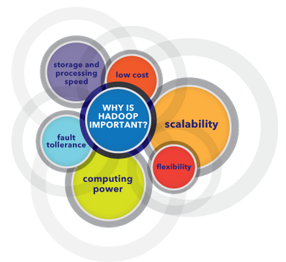
Why Hadoop….
Hadoop is an open source, Java-based programming framework.It provides massive storage for any kind of data, enormous processing power and the ability to handle virtually limitless concurrent tasks or jobs.

Slide 5

What is Apache Spark….
Apache Spark is a fast and general engine for big data processing, with built-in modules for streaming, SQL, machine learning and graph processing.
It is an open-source cluster computing framework with in-memory processing to speed analytic applications up to 100 times faster compared to technologies on the market today.
Spark runs on Hadoop, Mesos, standalone, or in the cloud. It can access diverse data sources including HDFS, Cassandra, HBase, and S3.

Slide 6

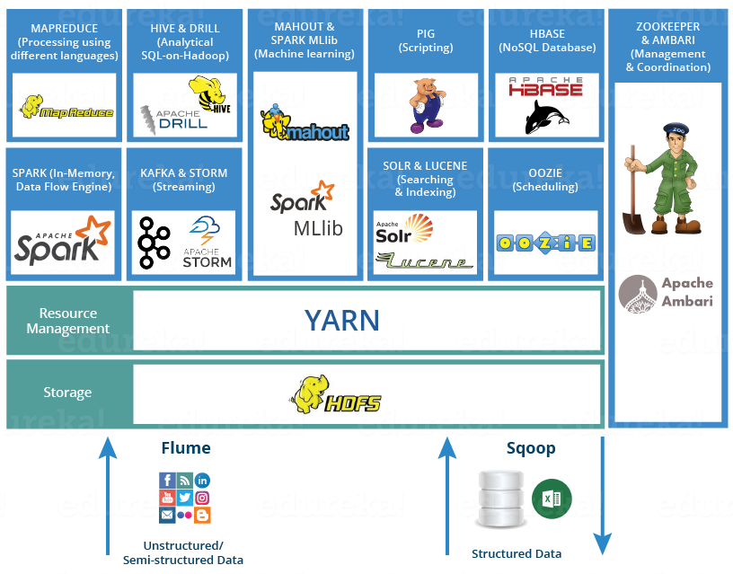
Soo why not others…. !!

Slide 7
MapReduce vs Apache Spark
Who Wins the Battle!
Apache Spark | MapReduce
Easy to program | Difficult to program
Executes jobs 10 to 100 times faster than Hadoop MapReduce. | MapReduce does not leverage the memory of the hadoop cluster to the maximum.
Programmers can modify the data in real-time through Spark streaming. | Allows you to just process a batch of stored data.
Has in-built interactive mode. | No in-built interactive mode except tools like Pig and Hive.

Slide 8
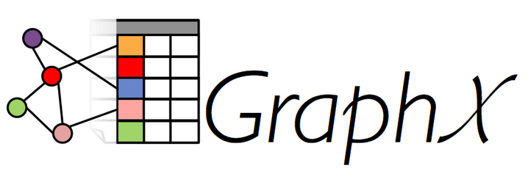
What’s GraphX ??
GraphX is a new component in Spark for graphs and graph-parallel computation.
At a high level, GraphX extends the Spark RDD by introducing a new Graph abstraction: a directed multigraph with properties attached to each vertex and edge.
There are various other graph processing systems namely, ApacheGraph, Pregel (GoldenOrb), Giraph, or Stanford GPS etc.
Pregel, PowerGraph are new graph-parallel systems and do not address the challenges of graph construction and transformation which are overcome by GraphX.

Slide 9
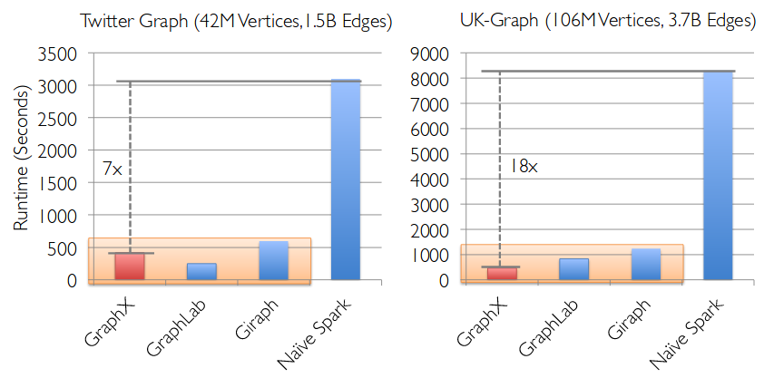
Why GraphX ??

Slide 10

Why should I learn Scala?
Scala is a type-safe JVM language that incorporates both object oriented and functional programming into an extremely concise, logical, and extraordinarily powerful language.
Java is a simple language whereas programming in Scala, on the other hand, has a slightly more complex structure. But if you can write a slightly more complex single line of code that replaces 20 “simpler” lines of Java, which one is really more complex?
The truth is that Java is often just way too verbose. In Scala, the compiler is incredibly smart, so this avoids the developer needing to specify things explicitly.

Slide 11
Implementation
Neighbour Queries
Number of Vertices
Number of Edges
InDegree of Vertices
OutDegree of Vertices
2. Neighbour of Neighbour Queries
Triangle Count
PageRank
Connected Components
Shortest Paths Algorithm

Slide 12
Queries in brief
numVertices - Calculates the number of vertices.
numEdges - Calculates the number of edges.
inDegrees - Calculates indegree of each vertex.
outDegrees - Calculates outdegree of each vertex.
triangleCount - Calculates number of triangles formed at each vertex.
pageRank - Calculates pagerank of each vertex.
connectedComponents - Calculates all the connected components.
ShortestPaths - Calculates Shortest paths from all vertices to a given vertex.

Slide 13
Observations - Neighbour Queries
Vertices | Edges | Vertex Time | Edge Time | InDegree Time | OutDegreeTime
88343 | 88342 | 2.86e-10 | 4.9e-10 | 0.49 | 0.47
175724 | 175723 | 4.5e-10 | 6.4e-10 | 0.838 | 0.854
437868 | 437867 | 4.7e-10 | 6.5e-10 | 0.798 | 0.765
874775 | 874774 | 8.06e-10 | 9.6e-10 | 0.639 | 0.406
1832884 | 2190082 | 1.87e-9 | 2.04e-9 | 0.599 | 0.528
3089630 | 4299211 | 3.91e-9 | 4.07e-9 | 1.370 | 0.500

Slide 14
Observations - Neighbour of Neighbour Queries
Vertices | Edges | Triangle Count Time | PageRank Time | Connected Components Time | Shortest Path Time
88343 | 88342 | 13.45 | 1.62 | 0.96 | 3.38
175724 | 175723 | 46.74 | 3.12 | 1.29 | 2.04
437868 | 437867 | 269.39 | 8.37 | 2.27 | 2.63
874775 | 874774 | 1512.4 | 13.49 | 3.03 | 5.19
1832884 | 2190082 | - | 84.9 | 18.366 | 6.83
3089630 | 4299211 | - | 262.4 | 119.3 | 26.81

Slide 15
Conclusion
We observed that with increase in size of data, parallelized computation time doesn’t vary much but the serialized queries have an exponential increase.
To compute larger data master - slave spark computations optimise the time.
We have also observed that the HDFS helps in dividing the file into blocks using locking mechanism which helps in optimizing queries with less resources.
Note: Source files and Graphs can be found in the Web page of the project.

Slide 16
THANK YOU !

